Slide 1


Lesson 5
Exploring Lean Portfolio Management
SAFe® Course - Attending this course gives students access to the SAFe® Agilist exam and related preparation materials.

Slide 2
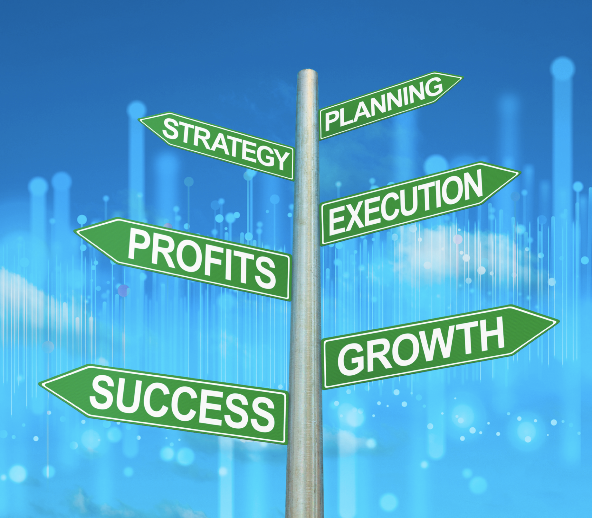
Why Lean Portfolio Management?
Traditional approaches to portfolio management were not designed for a global economy or the impact of digital disruption. These factors put pressure on enterprises to work under a higher degree of uncertainty and yet deliver innovative Solutions much faster.

Slide 3
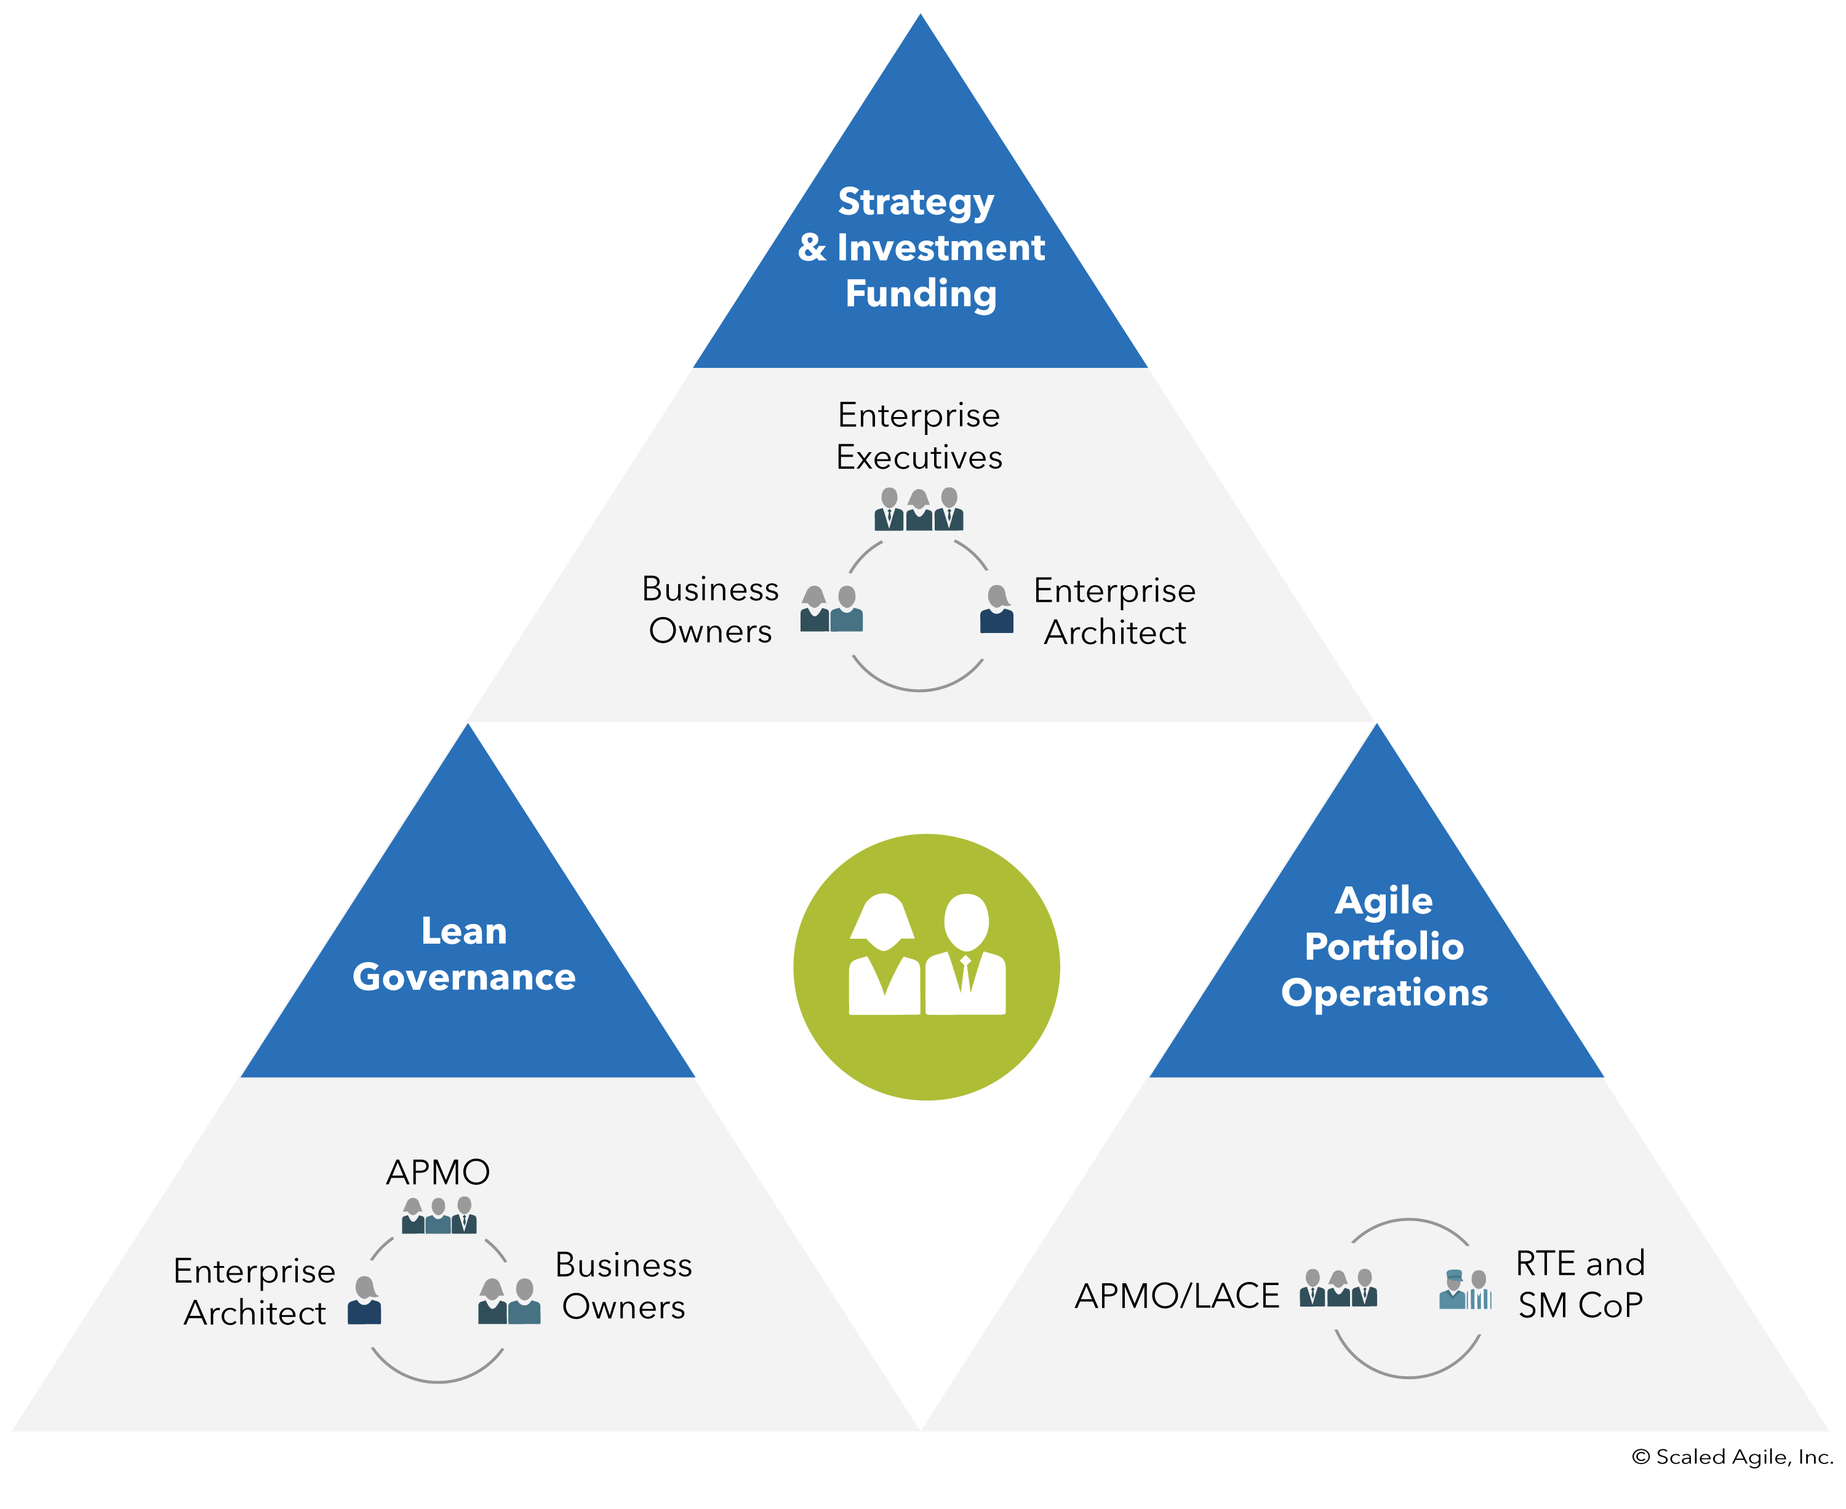
Lesson Topics
5.1 Defining a SAFe Portfolio
5.2 Connecting the portfolio to the Enterprise strategy
5.3 Maintaining the Portfolio Vision
5.4 Realizing the Portfolio Vision through Epics
5.5 Establishing Lean Budgets and Guardrails
5.6 Establishing portfolio flow
3
Notes:
Trainer Guidance:
Review the lesson 5 topics with the class. This lesson will focus on the Strategy and Investment Funding dimension of the Lean Portfolio Management competency.

Slide 4
Learning objectives
At the end of this lesson, you should be able to:
Describe the purpose and elements of a SAFe portfolio
Construct well-written strategic themes
Employ the portfolio canvas to describe the current and future state
Create Epic hypothesis statements to inform the Vision
Distinguish traditional and Lean budgeting approaches
Construct a Portfolio Kanban
Notes:
Trainer Guidance: Review each learning objective for Lesson 5 with the class.

Slide 5


The role of Lean Portfolio Management (LPM)
“
Most strategy dialogues end up with executives talking at cross-purposes because… nobody knows exactly what is meant by vision and strategy, and no two people ever quite agree on which topics belong where.
That is why, when you ask members of an executive team to describe and explain the corporate strategy, you frequently get wildly different answers. We just don’t have a good business discipline for converging on issues this abstract.
—Geoffrey Moore, Escape Velocity
Notes:
Trainer Guidance:
Most enterprises don’t have a clear understanding of strategy. Lean portfolio management aims to create that clarity.
References: Escape Velocity by Geoffrey Moore

Slide 6
5.1 Defining a SAFe portfolio

Slide 7
What is a SAFe portfolio?
A SAFe portfolio is a collection of development Value Streams.
Each Value Stream builds, supports, and maintains Solutions
Solutions are delivered to the Customer, whether internal or external to the Enterprise
7
Notes:
Trainer Guidance:
SAFe did not invent portfolios. Every organization has an established structure to prioritize and govern investments. SAFe’s portfolio is different in the way these functions are performed because it is based on Lean-Agile principles and the Lean-Agile mindset.
Tip: Ask the class, “What is a portfolio in your own worlds?” Some of the common answers include: “Our portfolio is a collection of work,” or “Our portfolio is a set of projects and investments.” Explain that the SAFe portfolio contains one or more development value streams, each of which support developing solutions that an enterprise or government agency needs to accomplish its business mission. A portfolio is often a single business unit to support a value stream and the solution it produces. It is a subset of the business. Solutions are what constitutes the portfolio.
Because solutions are long lasting, they are built and maintained via stable teams and ARTs, reducing long-term costs associated with project-based funding and increasing quality. Solution performance as measured by KPIs informs the portfolio in ongoing funding choices.
Note that the funding of value streams in portfolios that manage market-facing products is influenced and often “right-sized” by the revenue and profit generated by these solutions.

Slide 8

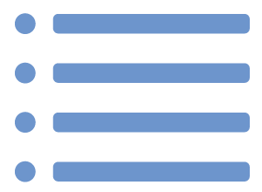
An Enterprise may have a single portfolio or multiple portfolios
SAFe Portfolio
Strategic Themes
Small Enterprise
Single Portfolios
SAFe Portfolio
SAFe Portfolio
SAFe Portfolio
Strategic Themes
SAFe Portfolio
Strategic Themes
Strategic Themes
Strategic Themes
Large Enterprise
Multiple Portfolios
8
Notes:
Trainer Guidance:
SAFe enterprises may have a single or multiple portfolios. In the small-to-midsize enterprises, one SAFe portfolio can typically govern the entire technical solution set. In larger enterprises, there can be multiple SAFe portfolios, typically one for each line of business, business unit, or division.
How to identify the SAFe portfolio?
By offering, e.g. in a bank you could have a separate portfolio for depository, lending, payments, investments.
By market: millennials vs boomers
By BU

Slide 9
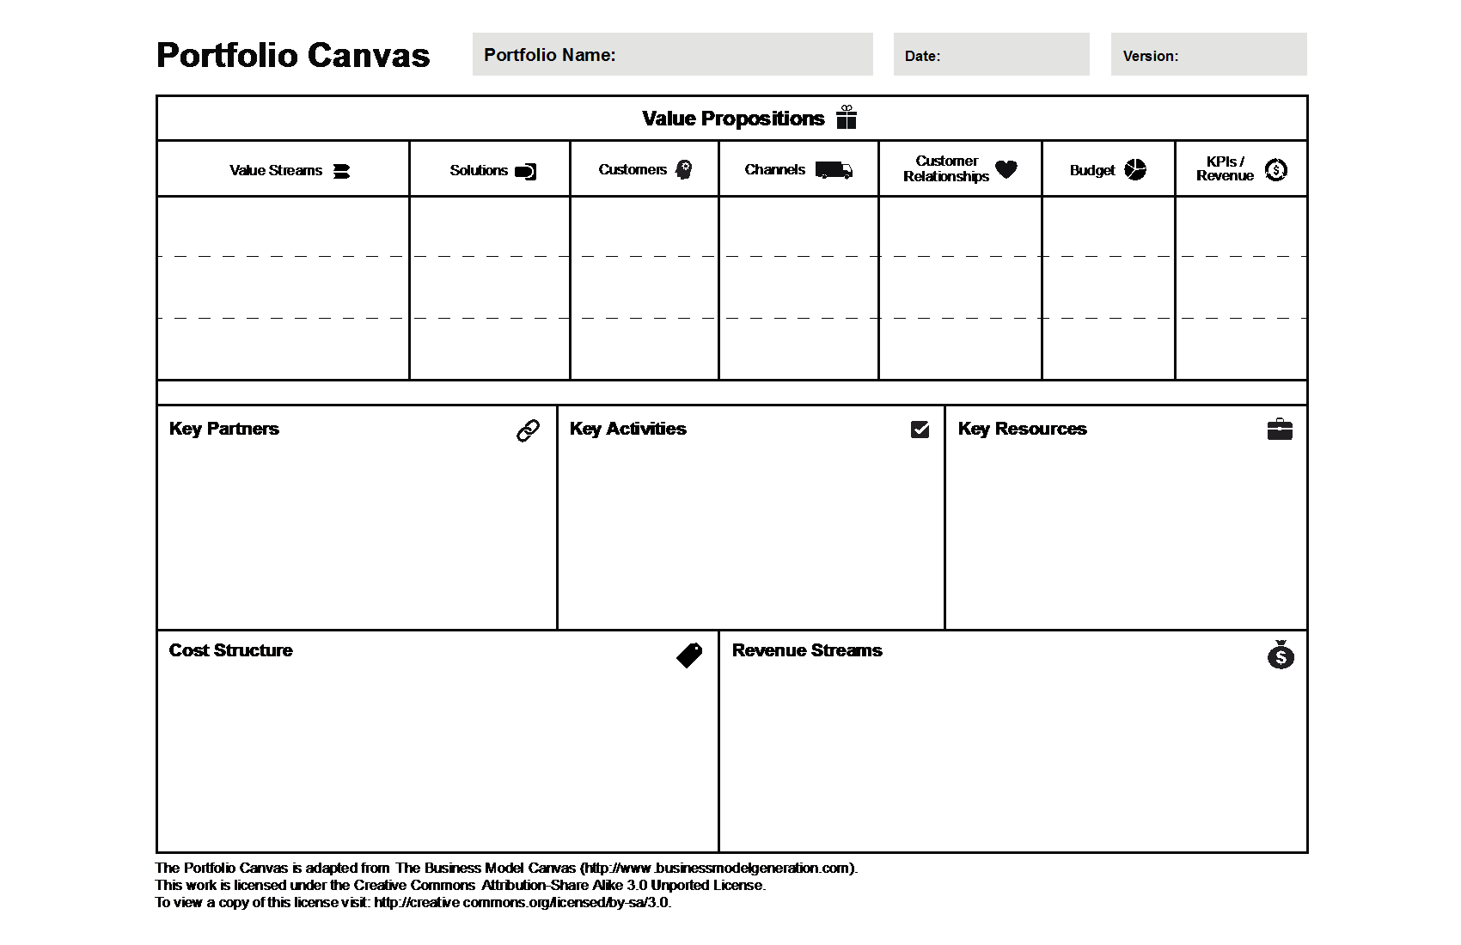
Define the portfolio with the portfolio canvas
The portfolio canvas is a template for identifying a specific SAFe portfolio
It defines the domain of the portfolio and other key elements
Notes:
Trainer Guidance:
The SAFe portfolio canvas is an adaptation of the business model canvas (BMC) that highlights the development value streams and other aspects specific to a SAFe portfolio. This canvas can be easily updated as the business changes and as new learning occurs. The nine original blocks of the BMC appear in a bold font with an icon. New blocks, which appear in a standard font, enable alignment of the portfolio canvas to specific SAFe constructs. There are three main sections of the portfolio canvas.
From top to bottom, horizontally, they are:
Value propositions - Describe the customers and the value delivered by the solutions of each value stream, as well as the customer segments and relationships, budget, and KPIs/revenue
Resources and activities - Describe the key partners, activities, and other resources needed to achieve the value propositions.
Cost structure and revenue streams - Describe how the portfolio’s costs are structured and define how revenue or value is achieved.

Slide 10
Map Solutions by horizon
Horizon 3
Horizon 2
Horizon 1
Horizon 0
Evaluating
Emerging
Investing
Extracting
Retiring
Decommission
Decommission
Notes:
Trainer Guidance:
The SAFe investment horizon model highlights spending allocations for solutions that are created by the individual value streams. This helps enable value stream owners and fiduciaries to make more informed decisions, and it helps align the portfolio with strategic themes while promoting overall health and growth, as well as identify holes in the current strategy.
Horizon 3 investments are those dedicated to investigating new potential solutions. Often, an epic is created to start the initiative, and an MVP is defined to test the benefit hypothesis. The investment continues until the initiative is stopped or allowed to continue to horizon two.
Horizon 2 reflects the investments in solutions which have emerged from horizon three. Since these are promising new solutions, the business is willing to make ongoing investments in excess of the current return. However, if the decision is made to stop the program, it’s likely that some modest investment is necessary to decommission the system, as it has likely made its way into the internal and external business ecosystem.
Horizon 1 reflects the desired state where solutions deliver more value than the cost of the current investment. These solutions require ongoing investment to maintain and extend functionality. This investment profile often consumes the majority of a portfolio budget, sometimes with lack of focus on innovation at other horizons.
Horizon 0 reflects the investment needed to decommission a deployed solution.

Slide 11
5.2 Connecting the portfolio to Enterprise strategy

Slide 12





Strategy and investment funding: Collaboration and responsibilities
Strategy and investment funding ensures that the entire portfolio is aligned and funded to create and maintain the Solutions needed to meet business targets.
Connect the portfolio to Enterprise strategy
Enterprise
Executives
Enterprise
Executives
Maintain a Portfolio Vision
Realize Portfolio Vision through Epics
Business
Owners
Business
Owners
Enterprise
Architect
Enterprise
Architect
Establish Lean Budgets and Guardrails
Strategy & Investment
Funding
Establish portfolio flow
Lean
Governance
Agile
Portfolio Operations
12
Notes:
Trainer Guidance:
Review this slide and the focus on the highlighted section when teaching this lesson. Note that the remaining bullets will be covered in subsequent lessons.

Slide 13
Elements of Enterprise strategy formulation
KPIs
Qualitative data
Lean Budget Guardrails
Portfolio context
Vision
Mission
Core values
Enterprise Strategy
Formulation
Enterprise
business drivers
Portfolio budgets
Strategic Themes
Distinctive competence
Financial goals
Competitive environment
13
Notes:
Trainer Guidance:
A strategy is best described as a plan of action to achieve the mission of the enterprise. Therefore, defining a strategy may be the most critical activity of every enterprise. An effective strategy answers four critical questions about the business:
What customers and markets do we serve?
What products and solutions do we provide?
What unique value and resources do we bring to the endeavor?
How will we extend these in the future?
Businesses have various approaches to develop enterprise strategy. This model was adapted from one of Jim Collins's earlier works and shows how the SAFe portfolio context influences enterprise strategy. The two critical outputs are the portfolio budgets and a set of strategic themes for each. Vision – Represents the future state of what the business wants to be. It’s persistent and long-lasting.
Mission – Identifies the business objectives that implement the enterprise vision and frame the strategy. They may be somewhat more temporal, and likely be incremental, in that each build on the one that came before. Core values – Provide the immutable belief system that governs all individual and corporate behaviors and activities.
Enterprise business drivers – Reflect the emerging industry themes and trends that affect the business.
Distinctive competence – Strategy naturally leverages distinctive capabilities, the unique advantages that differentiate this business from others, and provides a competitive edge.
Financial goals – Whether measured in revenue, profitability, people market share, or other metrics, financial performance goals should be clear to all stakeholders.
Competitive environment – Competitive analysis identifies the most significant competitive threats to the business.
Portfolio context – Knowledge of the current state of each solution portfolio informs enterprise strategy.

Slide 14
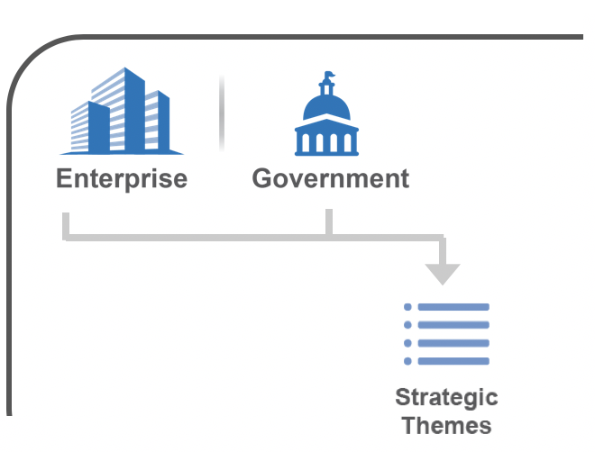
Connect the portfolio to the Enterprise with Strategic Themes
Strategic Themes are differentiating business objectives that:
Are a collaboration between LPM and the larger Enterprise
Drive the future state of a portfolio
Connect the Portfolio to the Enterprise strategy
Provide context for the Portfolio Vision and Lean budgeting
Good examples of Strategic Themes | Bad examples of Strategic Themes
Expand autonomous delivery into retail | Increase shareholder wealth
Expand autonomous delivery into healthcare | Maximize corporate wealth
14
Notes:
Trainer Guidance:
Describe what a strategic theme is and review the good and bad examples at the bottom of the slide. Ask the class what’s the problem with the bad examples. Answer: They are not differentiating business objectives that drive the future state of the portfolio.
Be sure to say that strategic themes are formulated via a collaborative process in which the enterprise executives and other fiduciaries work with Lean portfolio management and to develop the themes. This is often associated with the Strategic Portfolio Review and is often reviewed in the Portfolio Sync. (These events will be covered later in this lesson).

Slide 15





Influence of Strategic Themes
Strategic Themes influence portfolio strategy and provide business context for portfolio decision-making.
Portfolio Vision
Enterprise
Government
Portfolio Kanban and Portfolio Backlog
Vision for Solution, Program, and Team Backlogs
Strategic Themes
Value Stream Budgets
Investment Horizons
Capacity Allocation
Lean Budget Guardrails
Above portfolio threshold?
Approve Significant Initiatives
Business Owner Engagement
15
Notes:
Trainer Guidance:
Describe the influence of strategic themes and how they provide the context for decision-making. For example, strategic themes are direct inputs to the portfolio canvas and vision, as they may affect key partners and activities, customer segments, and so on. Strategic themes also have an influence on the vision and backlogs for development at every level of SAFe. For example, if an epic is not aligned with a strategic theme it probably should not be reviewed and analyzed. Strategic themes influence value stream budgets and guardrails. Always consider if the current investments in value streams reflect the changes necessitated by the strategic themes.

Slide 16


Activity: Identify Strategic Themes
Prepare
Share
5
3
Step 1: Identify three Strategic Themes that help define the strategy of your portfolio in the upcoming year
Step 2: Discuss:
Are these differentiators for your business or business as usual?
Step 3: Be prepared to share with the class
16
Notes:
Trainer Guidance:
Purpose: Recognize that strategic themes serve as drivers to economic decision-making.
Tips: Gain a better understanding of how strategic themes are used to connect a SAFe portfolio to the evolving enterprise business strategy. Understand what makes a good strategic theme by listening to each group report examples and by providing feedback.
Trainer Instructions:
Step 1: Have two to three teams share the strategic themes they identified.
Step 2: Ask the class to provide feedback on the themes identified by each group.
Ask: “Is this a theme differentiator? Is this theme too general or too specific? What did you learn during this exercise?”
Remote Guidance: A template for this activity is provided in the digital workbook.

Slide 17
5.3 Maintaining the Portfolio Vision

Slide 18
Identify opportunities for the portfolio’s future state with SWOT
Establishes an understanding of the portfolio’s strengths and weaknesses
Helps identify the most significant opportunities and potential threats
S
W
Strengths
Weaknesses
Internal Origin
O
O
T
Threats
Opportunities
External Origin
18
Notes:
Trainer Guidance:
There are many tools and techniques to help understand opportunities for the future state portfolio canvas. One of these techniques is a SWOT analysis which can be used to identify the strengths, weaknesses, opportunities, and threats related to business competition or a business plan. The SWOT analysis helps uncover opportunities for success that were previously unarticulated or to highlight threats before they become overly burdensome. The top 2 quadrants are internal, the bottom 2 quadrants are external.

Slide 19
TOWS strategic options matrix
External Opportunities (O)
External Threats (T)
The key difference between the SWOT and TOWS analyses are the outcomes that they create
TOWS analysis is used primarily for identifying strategic options to create a better future state
SWOT analysis is a great way to uncover the current situation of your Value Stream, product, or portfolio
1.
1.
2.
2.
3.
3.
4.
4.
Internal Strength (S)
SO
ST
1.
How can your strengths be used to exploit and maximize opportunities?
How can you apply your strengths to overcome present and potential threats?
2.
3.
4.
Internal Weaknesses (W)
WO
WT
1.
How can your opportunities be leveraged to overcome weaknesses?
How can you minimize weaknesses and avoid threats?
2.
3.
4.
19
Notes:
Trainer Guidance
The TOWS strategic options matrix, can help develop a plan for the future so that the business can survive and thrive in the long run.
The key difference between the SWOT and TOW analysis are the outcomes that they create. A SWOT analysis is a great way to uncover the current situation of your value stream, product or portfolio, while TOWS is used primarily for identifying strategic options to create a better future state.
Many teams find the WT quadrant hard: how can I minimize my weaknesses and avoid threats? One approach is to focus on Horizon 3 disruptive innovations. Don’t address your weakness: eliminate it by pursuing an entirely new approach! If you do this effectively, you’ll also neutralize any threats – because you’ll be operating in a new space.

Slide 20

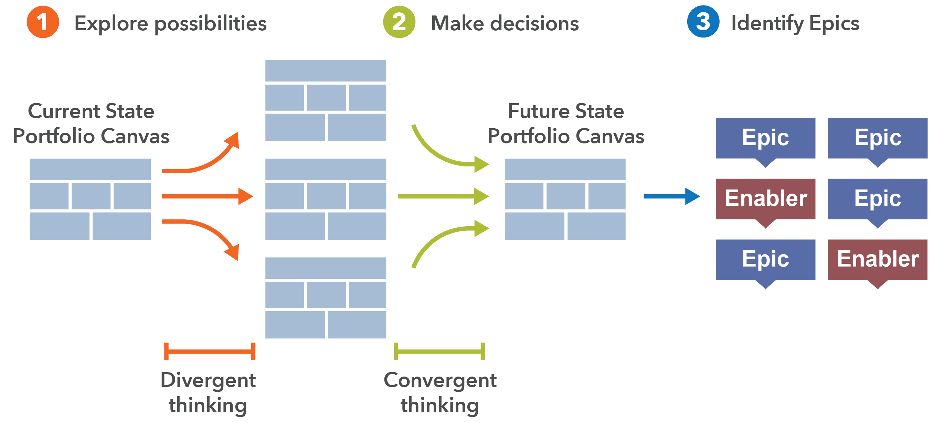




Envision the future state
The portfolio canvas captures the current state
Use SWOT and TOWS to brainstorm potential future states
Evaluate your options and select a future state
Identify the Epics that will get you to this future state
1
2
3
Explore possibilities
Make decisions
Identify Epics
Current State
Portfolio Canvas
Future State
Portfolio Canvas
Divergent Thinking
Convergent Thinking
Notes:
Trainer Guidance:
The portfolio’s strategic themes are one essential input. The LPM team uses the current state portfolio canvas as a starting point to explore the different ways in which the portfolio could evolve in alignment with the strategic themes. Start by selecting a specific block in the portfolio canvas, identifying a potential change or opportunity, and then explore how it impacts the other parts of the canvas. Some of the changes to achieve the future state will require implementing large initiatives or even new value streams, and the team will need to create business and enabler epics that drive these.

Slide 21


Express the future state as a Vision
A long view:
Vision: A postcard from the future
How will our portfolio of future solutions solve the larger customer problems?
How will these solutions differentiate us?
What is the future context within which our solutions will operate?
What is our current business context, and how must we evolve to meet this future state?
POSTCARD
Having a great time at a dream location...
Wish we were here!
Aspirational, yet realistic and achievable
Motivational enough to engage others on the journey
Result: Everyone starts thinking about how to apply their strengths in order to get there.
Switch: How to Change Things When Change is Hard, Heath and Heath, Broadway Books, 2010
Notes:
Trainer Guidance:
The portfolio vision sets a longer-term context for near-term decisions. Local decisions are made in light of a longer-term context, and inspirational people believe this is something really worth doing. Lean-Agile leaders largely have the responsibility to set the strategic direction of the company and to establish the mission for the teams who will implement that strategy. In the book Switch: How to Change Things When Change Is Hard, the authors call this longer-term view, a Destination Postcard.
Key Message:
A postcard from the future is a vivid picture from the near-term future that shows what could be possible. To create this postcard, imagine you are in that future. What is happening around you? What do you see that tells you have reached your goals? What do people say? Describe it in a concise (postcard-length) and concrete way.
People at work are thirsting for context, yearning to know that what they do contributes to a larger whole.—Daniel Pink
You’ve got to think about big things while you’re doing small things, so that all the small things go in the right direction.—Alvin Toffler
References: Switch: How to Change Things When Change Is Hard, Heath and Heath, Broadway Books, 2010

Slide 22
5.4 Realizing Portfolio Vision through Epics

Slide 23

What is a Portfolio Epic?
An Epic is a significant Solution development initiative. There are two types:
Business Epics directly deliver business value
Enabler Epics support the Architectural Runway and future business functionality
Portfolio Epics are typically cross-cutting, typically spanning multiple Value Streams and PIs
Epics need a Lean business case, the definition of a minimum viable product (MVP), an Epic Owner, and approval by LPM
Epic
Enabler
Portfolio Backlog
Feature
Feature
Enabler
Feature
Feature
Enabler
Feature
Feature
Feature
Feature
Program
Backlog
Story
Story
Story
Enabler
Story
Story
Story
Enabler
Story
Story
Story
Story
Story
Story
Team
Backlog
23
Notes:
Trainer Guidance:
Emphasis that in the simplest terms, Epics represent a significant opportunity, not a large collection of Features. There can be lots of great ideas that don't qualify as Epics. They may be more appropriately planned as Features. Also, not all Epics are Portfolio Epics.

Slide 24
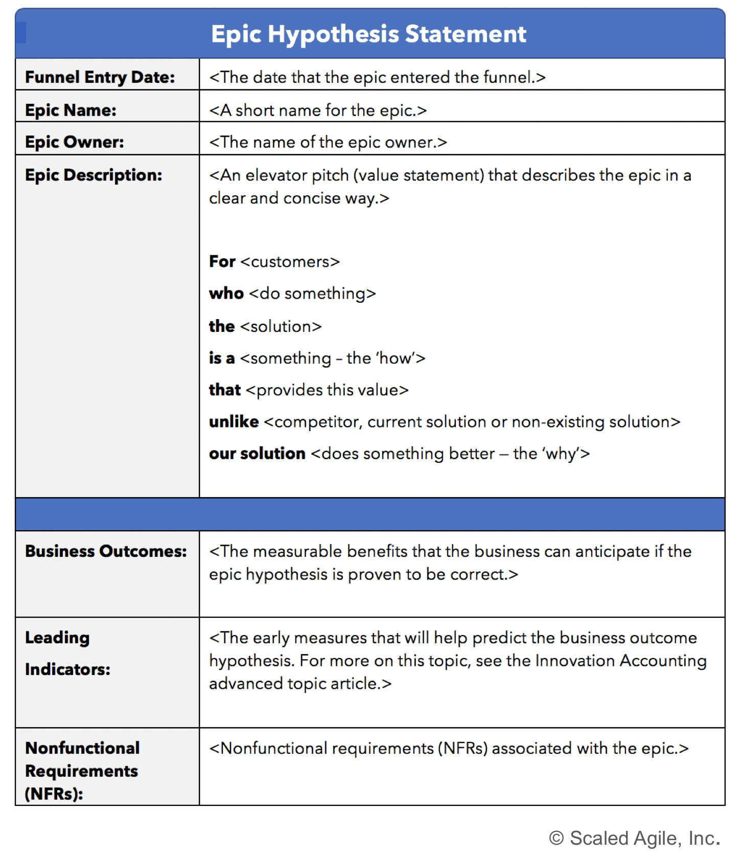
Epics are initially described with the Epic hypothesis statement
Epics are described with four major fields:
The value statement – Describes the Epic in general terms: the “for-who-the …” portion
Business outcomes hypothesis – States the quantitative or qualitative benefits that the business can anticipate if the hypothesis is proven to be correct
Leading indicators – Describe the early measures that will help predict the business outcomes
Nonfunctional requirements (NFRs) – Identify any NFRs associated with the Epic
24
Notes:
Trainer Guidance:
Reasoning about a potential epic must be based on a definition and intent that stakeholders can agree on. The epic hypothesis statement template serves as a tool that can be used to capture, organize, and communicate critical information about an epic.
Since epics are some of the most significant enterprise investments, stakeholders need to agree on their intent and definition. This slide provides an epic hypothesis statement template that can be used to capture, organize, and communicate critical information about an epic.

Slide 25
Activity: Epic writing
Prepare
Share
12
3
Step 1: In your group, identify an Epic from one of your contexts
Step 2: Write the Epic hypothesis statement
Step 3: Discuss:
What could be an MVP to validate this Epic?
Notes:
Trainer Guidance:
Epics are the primary drivers of the program portfolio vision, so they must be analyzed carefully before being committed to implementation. Learn how the epic value statement is a lightweight yet powerful way to begin the analysis of an epic.
Tips:
Writing a concise epic value statement takes thought but sets the stage for understanding and analysis.
The anticipated outcomes for epics are an important part of the epic analysis. They are used to validate that the implementation is complete and successful.
Nonfunctional requirements can cover a wide range of issues that are not covered by functional requirements and are an important part of the epic analysis.
Trainer Instructions:
Have the teams draft one epic on their flip chart for presentation, using the epic value statement format on the slide above. While these may take effort to write, they provide a great collaboration point.
Ask the teams to identify a possible MVP for the epic.
Ask one or two teams to present their epic, anticipated outcomes, and possible MVP.
Remote Guidance: A template for this activity is included in the digital workbook.

Slide 26
5.5 Establishing Lean Budgets and Guardrails

Slide 27









Problem: Cost-center budgeting
Traditional project-based, cost-center budgeting creates overhead and friction, lowers velocity.
A project requires collaboration of cost centers and assignment of people, budget, and schedule. It takes multiple budgets to build a single project budget.
Project effort estimate
Project cost estimate
Project
CC 2 Effort
CC 1 Effort
CC 3 Effort
CC 4 Effort
$
$
$
$
…
. . .
Result:
Slow, complex budgeting process
Leads to utilization-based planning and execution
Low program throughput
Moves people to the work
Cost center 1
Cost center 3
Enterprise
. . .
…
Cost center 2
Cost center 4
27
Notes:
Trainer Guidance:
The enterprise is organized into cost centers. Each must contribute to project spending or people (the primary cost element) to the new effort. This creates some problems:
The project budget process is slow and complicated. It requires many individual cost center budgets to fund the project.
It drives teams to make fine-grained decisions far too early in the ‘cone of uncertainty.’ If they can’t identify all the tasks, how can they reasonably estimate how many people are needed, and for how long? Their hand is forced.
People are assigned on a temporary basis. After the project is complete, people return to their organizational silo for future assignment within their cost center. And if they don’t, other planned projects will suffer.
The model drives cost-center managers to make sure everyone is fully allocated to one or more projects. However, running product development at 100 percent utilization is an economic disaster, resulting in high variability between forecasted and actual, time and costs.
The model prevents individuals and teams from working together beyond a single project. This hinders learning, team performance, and employee engagement. And collocation is out of the question. What happens if the project takes longer than planned, which often happens. Many people will have moved on to other projects, and further delays will occur.

Slide 28
Project overruns cause re-budgeting and increases cost of delay
Project estimate
What/who do we blame?
Technology challenge?
Change in scope?
The team?
Does it matter?
Planned:
Project
Actual:
Project
Result:
Wait for new budget approval; increase cost of delay (CoD)
Costly variance analysis; blame game; threatens transparency
Resource scramble reassignments
28
Notes:
Trainer Guidance:
Here’s an example of cost overrun – the blame game, etc. Product development cannot innovate without taking risks. Because it contains a high degree of technical uncertainty, it’s challenging to estimate product development: everyone knows that most things take longer than planned. Moreover, even when things go well, stakeholders may want a specific feature. That requires approval from a change control board, which adds further delay. Again, project-based funding hinders progress, culture change, and transparency. Project overruns often result in the blame game, which is unproductive and unhealthy.

Slide 29
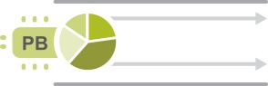
Solution: Fund Value Streams, not projects
Funding Value Streams provides for full control of spend, with:
No costly and delay-inducing project cost variance analyses
No resource reassignments
No blame game for project overruns
Lean Budgets
Guardrails
Value Streams
Solutions
Notes:
Trainer Guidance:
Ask: “What is our Lean-Agile solution?”
Answer: We put the money in the value stream instead!
LPM still controls the total spend. But now, people are committed to the program for an extended period of time. This also increases empowerment as many of the day-to-day budget decisions can become decentralized and shift as needed. We increase trust and transparency.
The final bullet has the phrase “blame game.” “Blame game” is when team members spend time attempting to assign blame for a failure instead of using their time to actually do value producing work.

Slide 30
Budgets are not affected by Feature overruns or changing priorities
Planned:
Feature 1
Feature 2
When a Feature takes longer than planned, keep people working on the right Feature for the right reasons
Feature 2
Actual:
Feature 1
Delay this Feature as necessary.
Fixed cost per PI
Notes:
Trainer Guidance:
When we fund a value stream, the local content authority (product or solution management) can make the decision of whether to keep investing in a feature that requires more investment or shift direction. We have many options now when we overrun, and they’re all based on the economic decision-making framework.

Slide 31
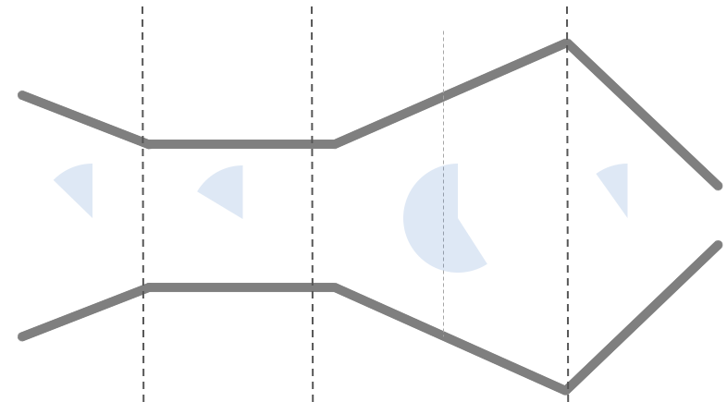
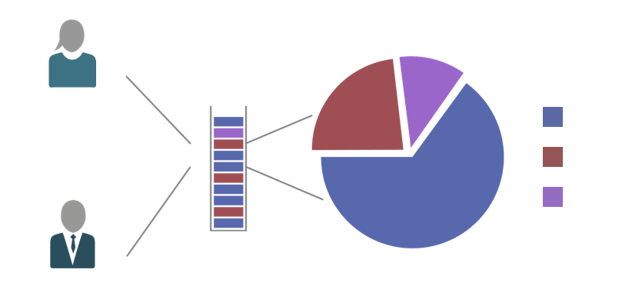
Maintain the Guardrails
Apply investment horizons
Utilize capacity allocation
Approve Epic initiatives
Continuous Business Owner engagement
1
2
3
4
WSJF
WSJF
31
Notes:
Trainer Guidance:
Guardrails describe portfolio-level budgeting, spending, and governance policies that:
Ensure the mix of investments balance near-term opportunities and long-term strategy and growth
Balance the backlog of new business Features with the need to continuously invest in the Architectural Runway and maintenance to avoid obsolescence and technical debt
Ensure large, significant investments (Epics) are approved appropriately
Actively engage Business Owners to ensure the priorities of the ARTs and Solution Trains are in alignment with the portfolio

Slide 32
5.6 Establishing portfolio flow

Slide 33

Govern Epic flow with the Portfolio Kanban
Makes largest business initiatives visible
Brings structure to analysis and decision-making
Provides WIP limits to ensure the teams analyze responsibly
Helps prevent unrealistic expectations
Helps drive collaboration among the key stakeholders
Provides a transparent and quantitative basis for economic decision-making
Notes:
Trainer Guidance:
The Portfolio Kanban system is a method to visualize and manage the flow of portfolio epics, from ideation through analysis, implementation, and completion. The portfolio Kanban is particularly important in that it helps align strategy and execution by identifying, communicating, and governing the selection of the largest and most strategic initiatives (Epics) for a SAFe portfolio. The portfolio Kanban is operated under the auspices of Lean Portfolio Management who use the strategic portfolio review and portfolio sync events to manage and monitor the flow of work.

Slide 34
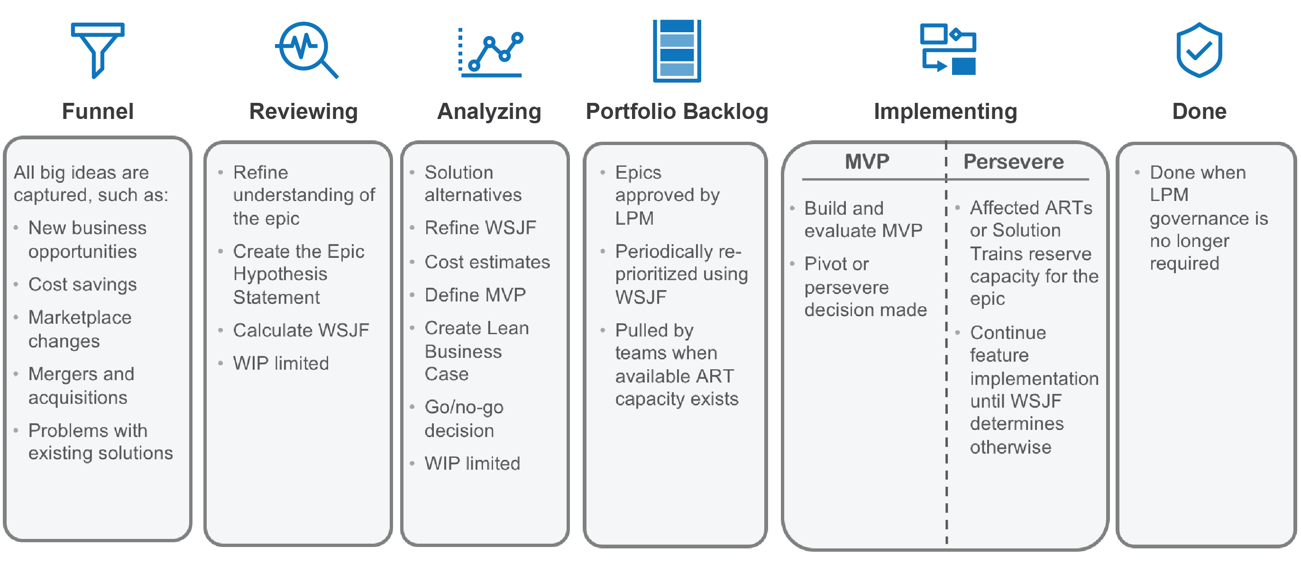
Epics flow through the Portfolio Kanban
The Portfolio Kanban system describes the process states that an Epic goes through from the funnel to done.
Funnel
Reviewing
Analyzing
Portfolio Backlog
Implementing
Done
All big ideas are captured, such as:
New business opportunities
Cost savings
Marketplace changes
Mergers and acquisitions
Problems with existing Solutions
Refine understanding of the Epic
Create the Epic hypothesis statement
Preliminary cost estimates and WSJF
WIP limited
Solution alternatives
Refined cost estimates and WSJF
Define MVP
Create Lean business case
Go/no-go decision
WIP limited
Epics approved by LPM
Sequenced using WSJF
MVP Persevere
Done when LPM governance is no longer required
Build and evaluate MVP
Pivot or persevere decision made
Pulled by teams
Affected ARTs or Solution Trains reserve capacity for the Epic
Continue Feature implementation until WSJF determines otherwise
Pull when an Epic Owner is available
Pull when an Epic Owner has capacity
Pull when approved by LPM
Pull when train capacity and budget available
Pull when MVP hypothesis proven true
Pull when Epic is no longer a portfolio concern
34
Notes:
Trainer Guidance:
The Portfolio Kanban system is a method to visualize and manage the flow of portfolio Epics, from ideation through analysis, implementation, and completion.
There are several Kanban systems used throughout SAFe, including the team, program, solution, and portfolio Kanban systems. These systems help match demand to capacity based on Work in Process (WIP) limits, and visualizing bottlenecks in each process state helps identify opportunities for relentless improvement. Kanban systems also include policies governing the entry and exit of work items in each state.
The portfolio Kanban system, as illustrated on this slide, describes the process states that an epic goes through on its way to from creation through completion. The advancement of the epic through the portfolio kanban is coordinated by the epic owner. Each of the default portfolio Kanban states is described in the details on the slides that follow. It’s important to note that these portfolio Kanban states represent an example process. The design of the Kanban should evolve to reflect improvements the default Kanban states based on relevant portfolio experience. These improvements may include adjusting WIP limits, splitting or combining Kanban states, or adding classes of service to optimize the flow and priority of epics.
At the bottom of each state are the entry criteria that describe when new work can be pulled from the previous state.

Slide 35
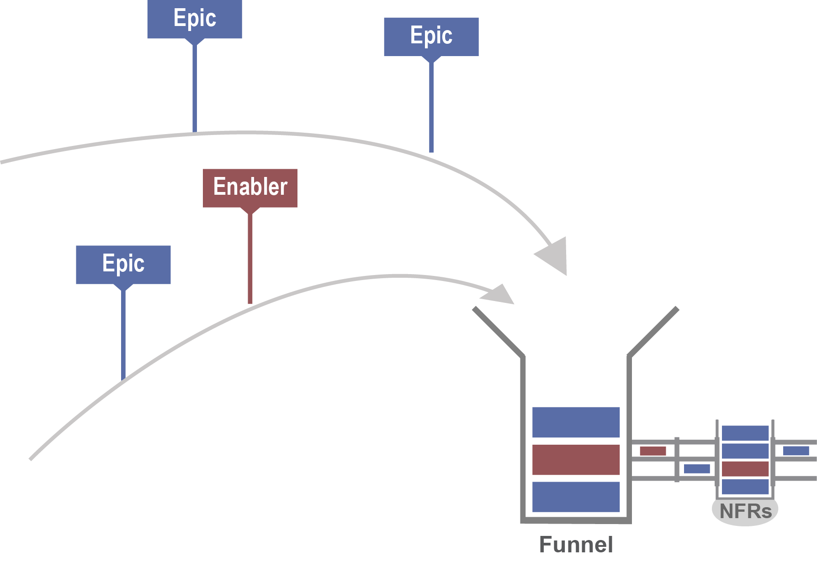
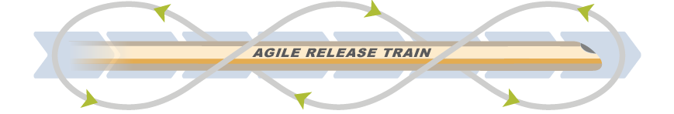

Feed the portfolio funnel
Epic
Portfolio Vision
Epic
Current State
Portfolio Canvas
Future State
Portfolio Canvas
Portfolio Roadmap
Enabler
Epic
Solution Vision
ART 3
ART 2
ART 1
Solution Roadmap
Funnel
35
Notes:
Trainer Guidance:
The funnel is used to capture all new big ideas. They can come from any source and may be business or technical concepts (enablers).
Typical drivers of Epics include:
Strategic Themes
unanticipated changes in the marketplace
business acquisitions
Mergers
responses to competitors
improving the efficiency or cost of a solution or its operation
problems with existing solutions that hinder business or technical performance
Epics are typically described using a short phrase on card, such as, “self-service for all auto loans.” Epics that meet the decision criteria are then moved to the next state, ‘Reviewing.’ There is no WIP limit for the funnel since it’s just used for intake of potential new Epics. Epics could come from team members, from hackathons, from customers, from partners, from numerous other sources.

Slide 36
MVPs foster innovation and control scope
SAFe Lean Startup Cycle
Create new Epic and hypothesis
Yes
Epic
Build and evaluate MVP
Epic state: MVP
Hypothesis proven?
No
Pivot?
Portfolio Kanban
Approved Lean business case with a defined MVP and business outcome hypothesis
Epic state: Portfolio Backlog
Yes
No
Development continues
Epic state: Persevere
or
If portfolio governance is
no longer required
Epic state: Done
Stop
Note: Many experiments are possible here!
Development stops
Epic state: Done
Continue
until WSJF determines otherwise
Local Features and other Epic input
Program Kanban systems
Notes:
Trainer Guidance:
The Lean Startup strategy recommends a highly iterative build-measure-learn cycle for product innovation and strategic investments. This strategy for implementing epics provides the economic and strategic advantages of a Lean startup by managing investment and risk incrementally while leveraging the flow and visibility benefits of SAFe.
A minimum viable product (MVP) is developed as part of the Lean startup cycle. It includes the smallest portion of the epic needed to understand whether or not the epic hypothesis statement is validated. This MVP will be the part of the epic flowing through the rest of the portfolio Kanban system.
Gathering the data necessary to prove or disprove the Epic Hypothesis is a highly iterative process that continues until a data-driven result is obtained or the team consumes the MVP budget.
If the hypothesis is proven true, the epic enters the persevere state, which will drive more work by implementing additional features and capabilities. ARTs manage any further investment in the Epic via ongoing WSJF feature prioritization of the Program Backlog. Local features identified by the ART, and those from the epic, compete during routine WSJF reprioritization.
However, if the hypothesis is proven false, Epic owners can decide to pivot by creating a new epic for LPM review or dropping the initiative altogether and switching to other work in the backlog. After evaluating an epic’s hypothesis, it may or may not be considered to remain as a portfolio concern. However, the Epic Owner may have some ongoing responsibilities for stewardship and follow-up.

Slide 37
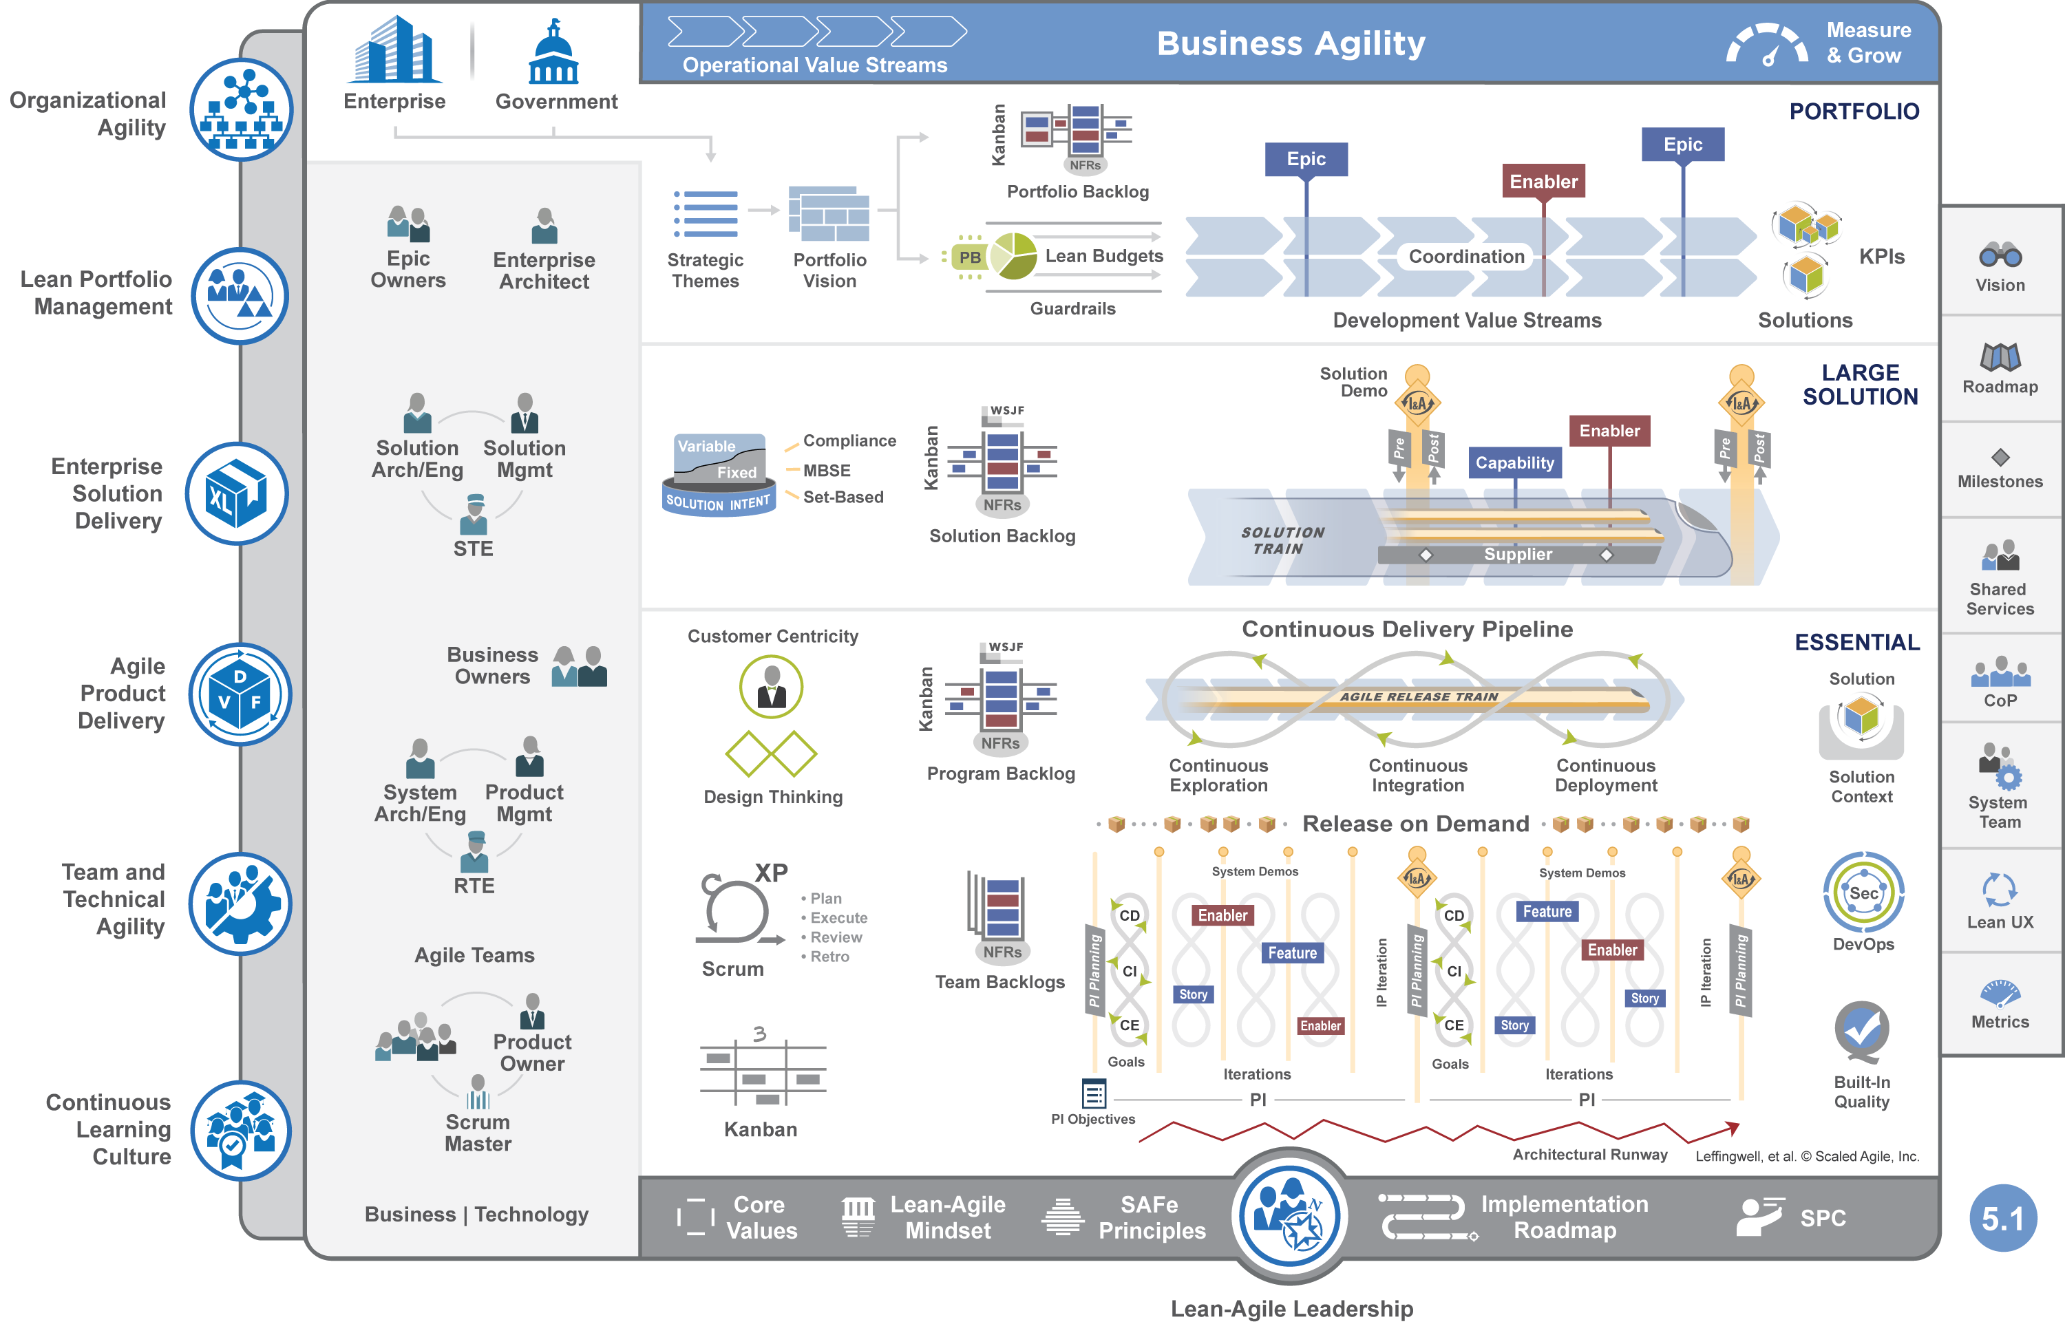

Lesson review
In this lesson you:
Described the purpose and elements of a SAFe portfolio
Constructed well-written strategic themes
Reviewed the Portfolio Canvas to describe the current and future state
Created Epic hypothesis statements to inform the Vision
Distinguished traditional and Lean budgeting approaches
Discussed the Portfolio Kanban
Scaled Agile Framework Readings:
Lean Portfolio Management, Strategic Themes, Portfolio Vision, Lean Budgets, Guardrails, Portfolio Kanban, Epics
Notes:
Trainer Guidance: You may recommend the following articles to the learners, which are also listed in their workbooks: Lean Portfolio Management, Strategic Themes, Portfolio Vision, Lean Budgets, Guardrails, Portfolio Kanban, Epics

